Slide 1

Welcome back!
Studio S5
Ma Chi Kin Brian
e1121386@u.nus.edu
Tele: @bmanara

Slide 2
How was RA1?

Slide 3
Agenda for Today
Admin Matters
Recap
S5 Studio Worksheet
S5 In-Class Studio Worksheet

Slide 4
Admin Matters
Mastery Check 1
10 mins F2F or Online meeting (I personally prefer F2F but online works too)
Scope: Higher Order Functions, Scoping, Substitution Model, Recursion (Recursive and Iterative Processes)
My free Time Slots
Monday: 1200hrs - 1630hrs (F2F/Online)
Wednesday: Whole Day (Online)
Thursday: 1000hrs - 1530hrs (F2F/Online)
Friday: 1200hrs onwards (F2F/Online)
Or lmk what other timeslots you intend to meet up (I’ll see what I can do)

Slide 5
Admin Matters
Mastery Check 1
What to do and how to do?
Prepare a “presentation” on the topics covered
Will have to show that you have “mastered” the topic
Pass/Fail Grading
Ensure that your pair understands and can explain too!
Pass/fail is given together as a pair…
Can either use presentation slides, drawings, Source Academy examples etc.
If failed, don’t worry! Reschedule and try again!

Slide 6
RECAP
Pairs and Lists
List Discipline
Box & List Notations
Box-and-Pointer Diagrams
List Processing

Slide 7
Data Structures
Types of Values in Source:
Numbers: -1, 2, -5.6…
Boolean Values: true, false
Strings: “i am a string”
Functions: x => x + 1
Others (imported from modules): heart, make_point
Now, let’s talk about pairs and lists

Slide 8
Implementing Pairs
How can we implement this?
Try to recall what was went through in Wednesday’s Lecture…

Slide 9
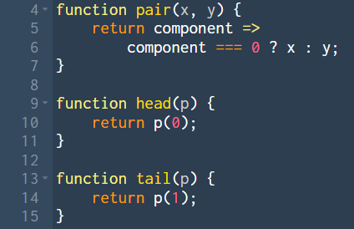
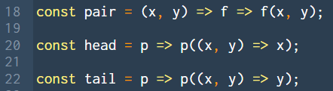
Implementing Pairs

Slide 10
Lists, what are they?

Slide 11
Lists, what are they?
We create lists using pairs!
There are many possible ways you could do this though… so let’s set some ground rules.
List Discipline:
We represent empty lists as null in Source.
A list of a certain type is null or a pair whose head is of that data type and whose tail is a list of that data type.
Does not matter what the head is, could be a pair, a list, or just a regular value!

Slide 12
LISTS Functions
pair(x, y)
is_pair(p)
null
is_null(xs)
head(p)
tail(p)
list(x₁, x₂, …, x_{n})

Slide 13
Pair and List Notation
pair(1, pair(2, pair(3, null)))
Box Notation: [1, [2, [3, null]]]
List Notation: list(1, 2, 3)
list(1, 2, pair(3, 4), list(5))
Box Notation: [1, [2, [[3, 4], [[5, null], null]]]]
List Notation: list(1, 2, [3, 4], list(5))

Slide 14
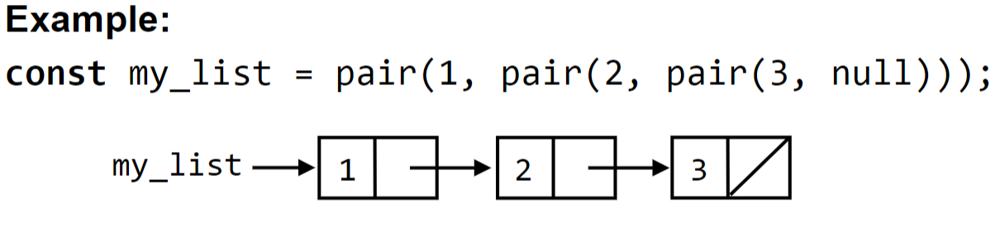
Box-and-Pointer Diagrams
Use draw_data to check in Source!

Slide 15
Finding the length of a list
Definition: Length of an empty list is 0, length of non-empty list is one more than the tail.
How do we get the length of a list?

Slide 16
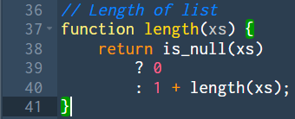
Finding the length of a list
Use Recursion!

Slide 17
Appending two lists
How to implement append(list1, list2)?

Slide 18
Appending two lists
Strategy for append(list1, list2):
If list1 is empty
return list2
Otherwise, wishful thinking…
Create a new pair
Head of pair: head of list 1
Tail of pair: append(tail(list1, list2))

Slide 19
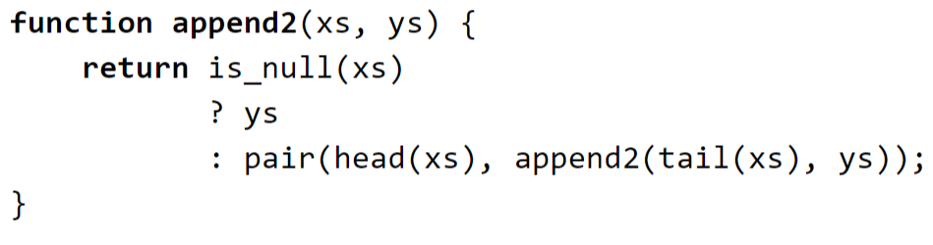
Appending two lists
Strategy for append(list1, list2):
If list1 is empty
return list2
Otherwise, wishful thinking…
Create a new pair
Head of pair: head of list 1
Tail of pair: append(tail(list1, list2))

Slide 20
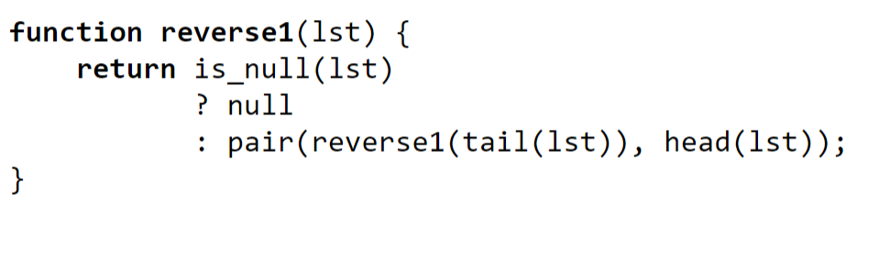
Reversing a list
Does this work?

Slide 21
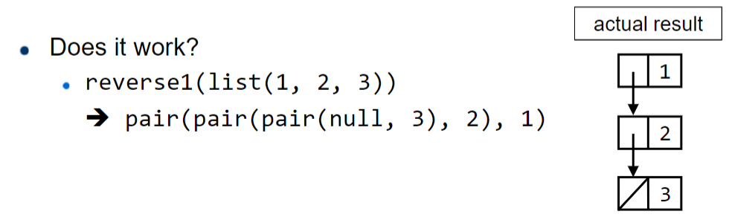
Reversing a list
Does this work?

Slide 22
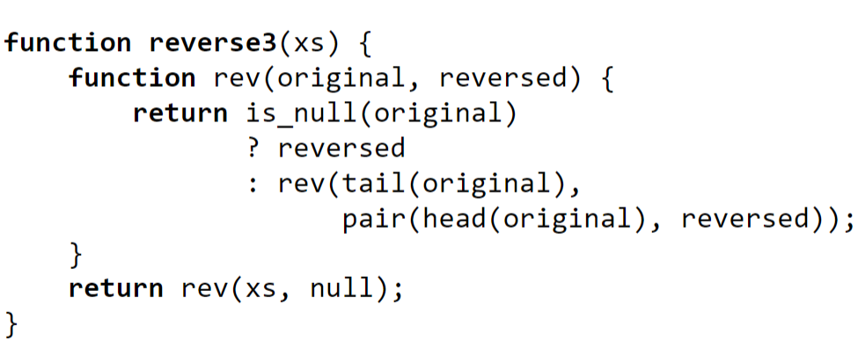
Reversing a list
This works!
Why?

Slide 23
Higher Order List Processing
map
filter
accumulate
What do they do?

Slide 24
Higher Order List Processing
map : applies function to all elements in the list
filter : removes elements from list if element returns false from pred
accumulate : takes first element and initial, applies op to both, takes the result and repeats with next elements

Slide 25
Higher Order List Processing
map(f, xs)
filter(pred, xs)
accumulate(op, initial, xs)
Implementation? (Try to use conditional expressions, not if-else statements)

Slide 26
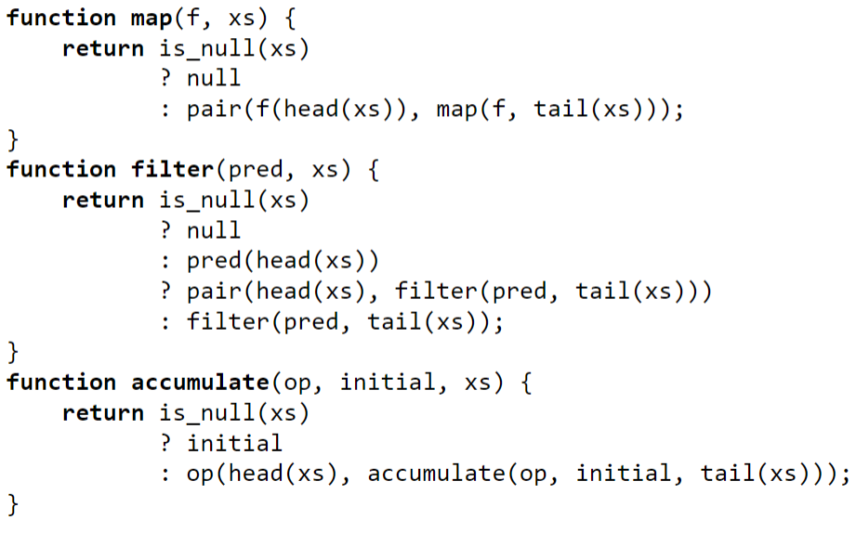
Higher Order List Processing

Slide 27

Box & Pointers
S5 Studio Sheet

Slide 28
Lists, lists and… more lists
S5 In-class Studio Sheet

Slide 29
See you next week!
Slides will be uploaded to the google drive.
Any questions you want to go through for your RA1 Paper?

